Slide 1
Repair towards remission: epithelial-driven inflammation and opportunities to restore epithelial barrier function
Dr Julia Eckl-Dorna
General Hospital Vienna, Medical University of Vienna, Vienna, Austria

Slide 2
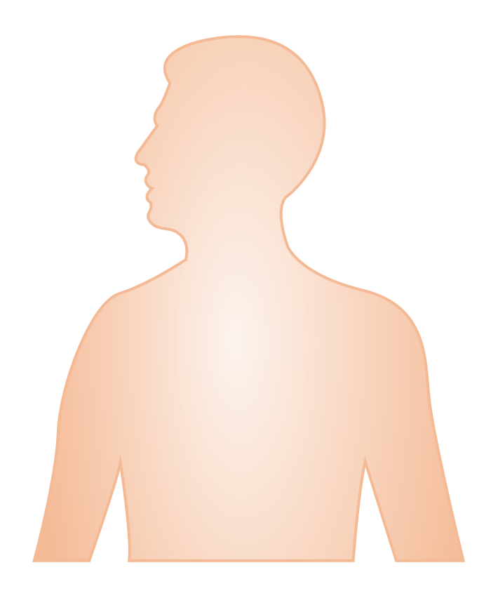
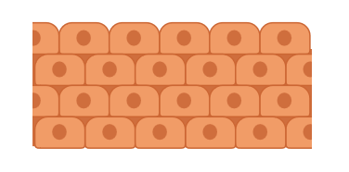


There are similarities in the cellular composition and structure of the upper and lower airway epithelium^{1–3}
Stratified squamous epithelium
Nasal cavity
Forms a physical barrier
Pseudostratified columnar ciliated epithelium
Upper airways
Facilitates mucus clearance
Releases effector molecules
Differentiates into ciliated cell and goblet cell lineages
Secretes mucus
Pseudostratified columnar ciliated epithelium
Facilitates mucus clearance
Drives bronchoconstriction
Lower airways
Secretes protective substances
Releases effector molecules
Differentiates into ciliated cell lineages
Cuboidal / simple squamous epithelium
Bronchioles and alveoli
Participates in surfactant production
Facilitates gas exchange
Airway smooth muscle cell
Basal
cell
Basement membrane
Ciliated
cell
Club
cell
Goblet
cell
Squamous
cell
Tuft
cell
Type 1 alveolar epithelial cell
Type 2 alveolar epithelial cell
Figure adapted from Laulajainen-Hongisto A, et al. Front Cell Dev Biol. 2020;8:204, Baldassi D, et al. Adv Nanobiomed Res. 2021;1(6):2000111 and Adivitiya, et al. Biology (Basel). 2021;10:95.
References: 1. Laulajainen-Hongisto A, et al. Front Cell Dev Biol. 2020;8:204; 2. Licari A, et al. Front Pediatr. 2017;5:44; 3. Fokkens W, Reitsma S. Otolaryngol Clin North Am. 2023;56(1):1–10; 4. Adivitiya, et al. Biology (Basel). 2021;10(2):95; 5. Baldassi D, et al. Adv Nanobiomed Res. 2021;1(6):2000111; 6. Zhang R, et al. Int Arch Allergy Immunol. 2023;1–21; 7. Davis JD, Wypych TP. Mucosal Immunol. 2021;14(5):978–90;
8. Jakwerth CA, et al. Cells. 2022;11(9):1387; 9. Doeing DC, Solway J. J Appl Physiol (1985). 2013;114(7):834–43.

Slide 3
Comorbidities are common in with patients with asthma¹
In adults with asthma, 60% have at least one comorbid condition and 12% have three or more
comorbid conditions¹
Common comorbidities include:
COPD²
Rhinitis¹
Rhinosinusitis¹
Respiratory infections¹
  27% of patients with asthma have concurrent COPD
  Present in >80% of patients with asthma
  Up to 84% of patients with severe asthma have evidence of rhinosinusitisª
  During asthma exacerbations, viral agents are detected in about 80% of children and in 41–78% of adults
ªAs assessed by sinus computed tomography.¹
Abbreviation: COPD, chronic obstructive pulmonary disease.
References: 1. Boulet LP, Boulay MÈ. Expert Rev Respir Med. 2011;5(3):377-93; 2. Hosseini M, et al. Respir Res. 2019;20(1):229.

Slide 4
‘United airways disease’: considering the upper and lower airways as an anatomically and functionally unified organ^{1–3}
Nasal cavity
Upper respiratory tract
Upper airway diseases
(eg chronic rhinosinusitis, rhinitis)
Pharynx
Larynx
United airways disease
Trachea
Lower respiratory tract
Bronchi
Bronchioles
Lower airway diseases
(eg asthma)
Alveoli
Figure adapted from Baldassi D, et al. Adv Nanobiomed Res. 2021;1(6):2000111 and Ball M, et al. Available at: https://www.ncbi.nlm.nih.gov/books/NBK459258/. StatPearls Publishing; 2023.
References: 1. Fokkens W, Reitsma S. Otolaryngol Clin North Am. 2023;56(1):1–10; 2. Jakwerth CA, et al. Cells. 2022;11(9):1387; 3. Licari A, et al. Front Pediatr. 2017;5:44; 4. Van Scott MR, et al. Airway anatomy, physiology, and inflammation. In: Meggs WJ, ed. The toxicant induction of irritant asthma, rhinitis, and related conditions (1st ed). New York, NY, USA: Springer; 2013:19–62; 5. Baldassi D, et al. Adv Nanobiomed Res. 2021;1(6):2000111; 6. Ball M, et al. Available at: https://www.ncbi.nlm.nih.gov/books/NBK459258/. StatPearls Publishing; 2023.

Slide 5



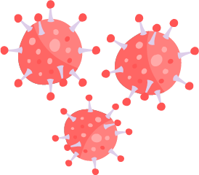
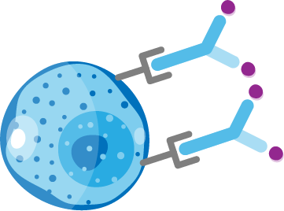
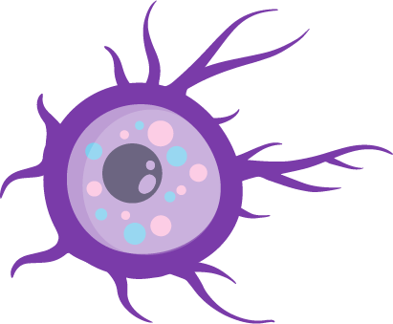





Epithelial derived cytokines are central in driving T2 diseases^{1–3}
Pathogens, air pollutants, chemicals etc.
Goblet cell hyperplasia and mucous hypersecretion
Lower airways
15
Upper airways
Total IL-33 in BALF
IL-33
100
p = 0.0002
Ciliated cell
Basal cell
Neuroendocrine
cell
Goblet cell
10
p=0.003
10
BM thickening
IL-33 pg/mL
Median IL-33 (pg/mg)
1
5
IL-25, IL-33, TSLP
0.1
ASM traction and AHR
Controls
Asthma
0
DC
6
Nasal Polyp
Control
Total TLSP in BALF
ILC2
Th2
TSLP
1,000
5
p = 0.009
MC
4
100
Mast cells and degranulation
p=0.021
3
IL-33 pg/mL
Median TSLP (pg/mg)
10
IgE
2
EOS
1
B cell
PC
1
0.1
Eosinophils and degranulation
0
Controls
Asthma
B cell, plasma cell and
antigen-specific IgE
Nasal Polyp
Control

Slide 6
Disturbed homeostasis of the respiratory epithelium in
T2 disease¹
Homeostasis¹
CRS¹
Impairment of barrier integrity
Mucociliary clearance dysfunction
Immune disorder
Excessive tissue remolding
Intact epithelium and barrier function
Pathogens, air pollutants, chemicals etc.
Risk factors:
Genetic/epigenetic, microenvironmental, signal transduction, etc.
Epithelial cell differentiation and barrier reconstruction
Impairment of tight junctions and epithelial barrier
Epithelial cell death and barrier breakdown
Abnormal proliferation and differentiation of epithelial cells impede barrier reconstruction
Regeneration of epithelial stem cells

Slide 7
The airway epithelial barrier integrity is reduced in asthma^{1,2}
Healthy
Asthma
Mucus
Increased
mucin content
Cilial disorientation
and loss of cilia
Epithelium
Tight
junctions
Small gaps in the
tight junctions
In people with asthma the epithelial barrier permeability is increased due to dysfunction in the tight junctions between epithelial cells^{1,2}
Cilial disorientation and loss of cilia disrupts the clearance of mucus, which is also more viscous than in
healthy people³
Figure adapted from Frey A, et al. Front Immunol. 2020;11:761.
References: 1. Looi K, et al. Exp Lung Res. 2016;42(7):380–95; 2. Saatian B, et al. Tissue Barriers. 2013;1(2):e24333; 3. Frey A, et al. Front Immunol. 2020;11:761.
7

Slide 8
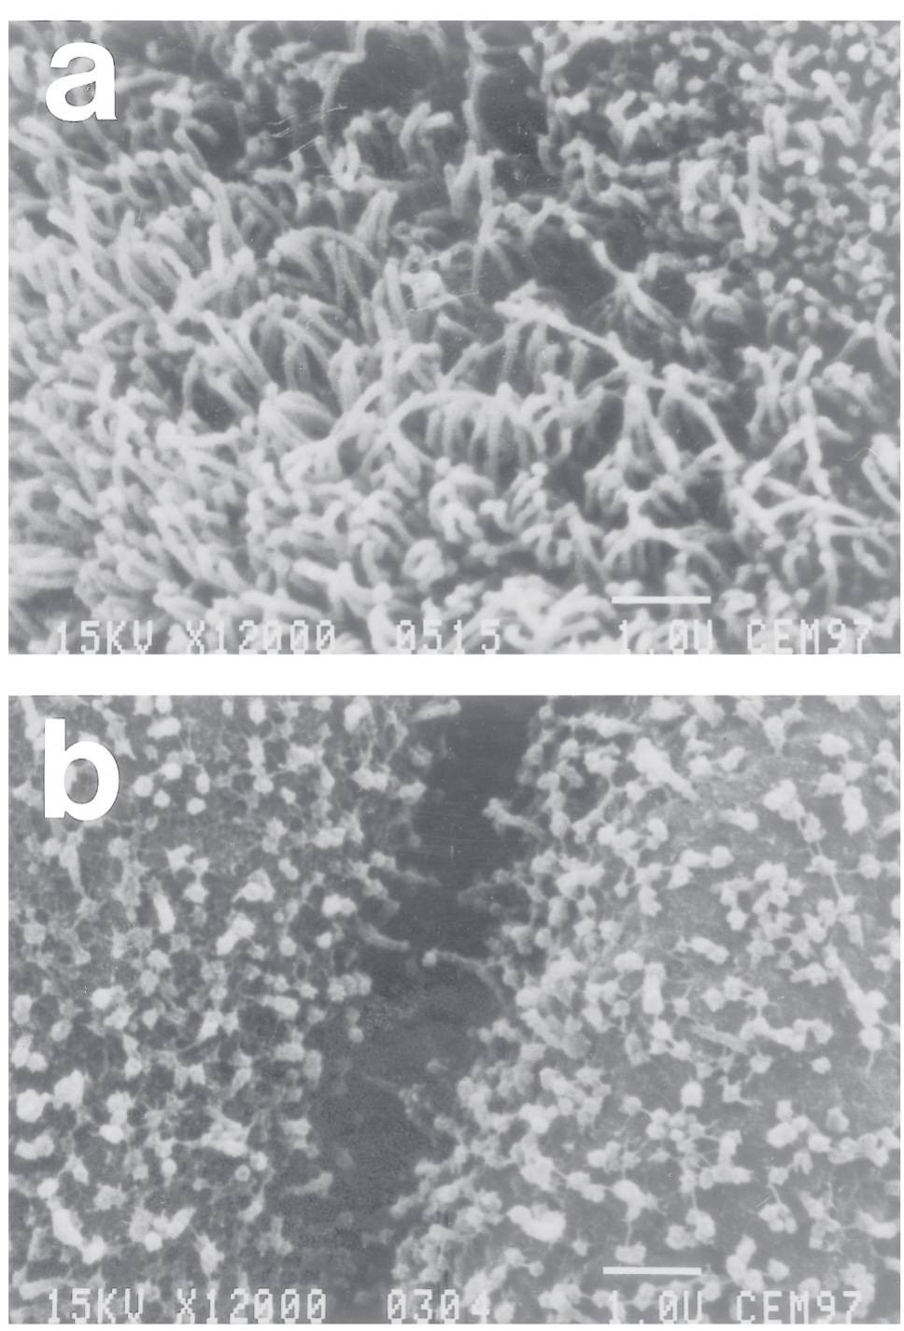
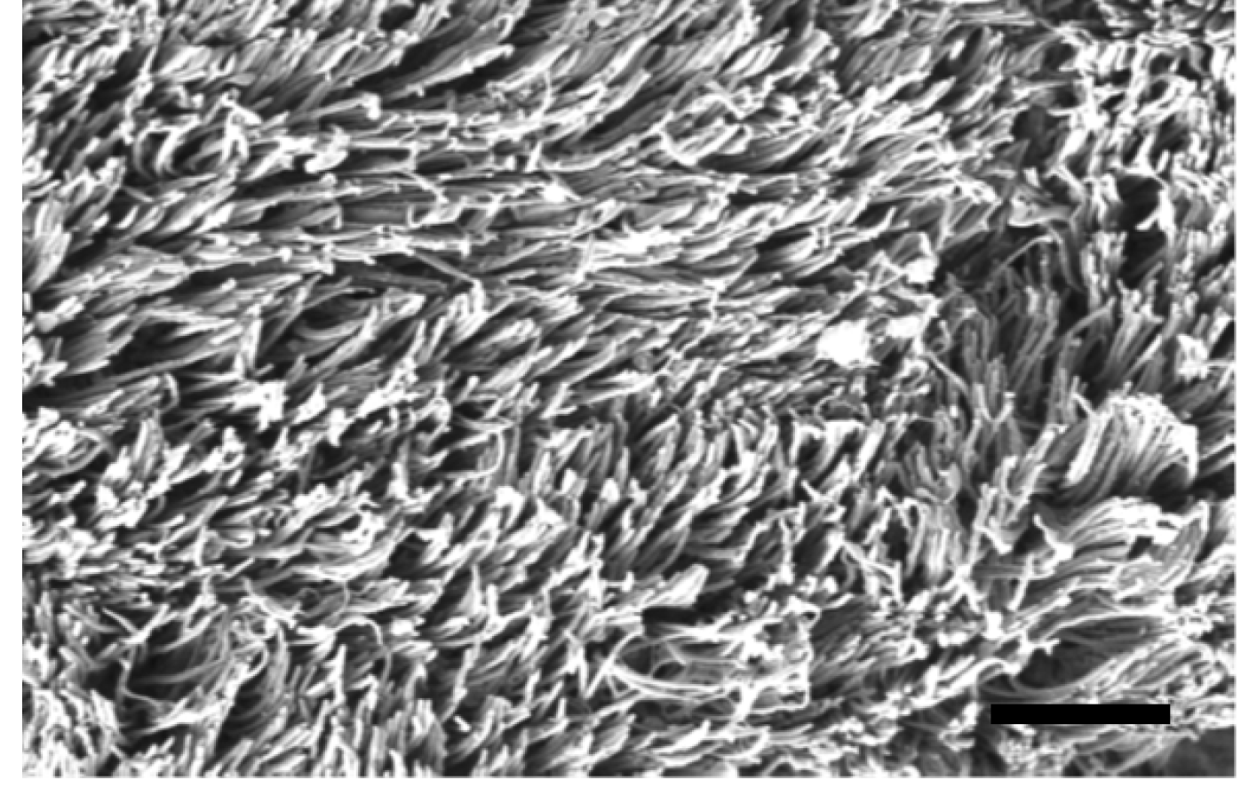
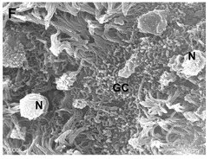
Cilia dysorientation and loss of cilia in asthma and CRS^{1–3}
Lower airways
Upper airways
Healthy¹
Healthy²
Asthma¹
CRS^{2a}

Slide 9
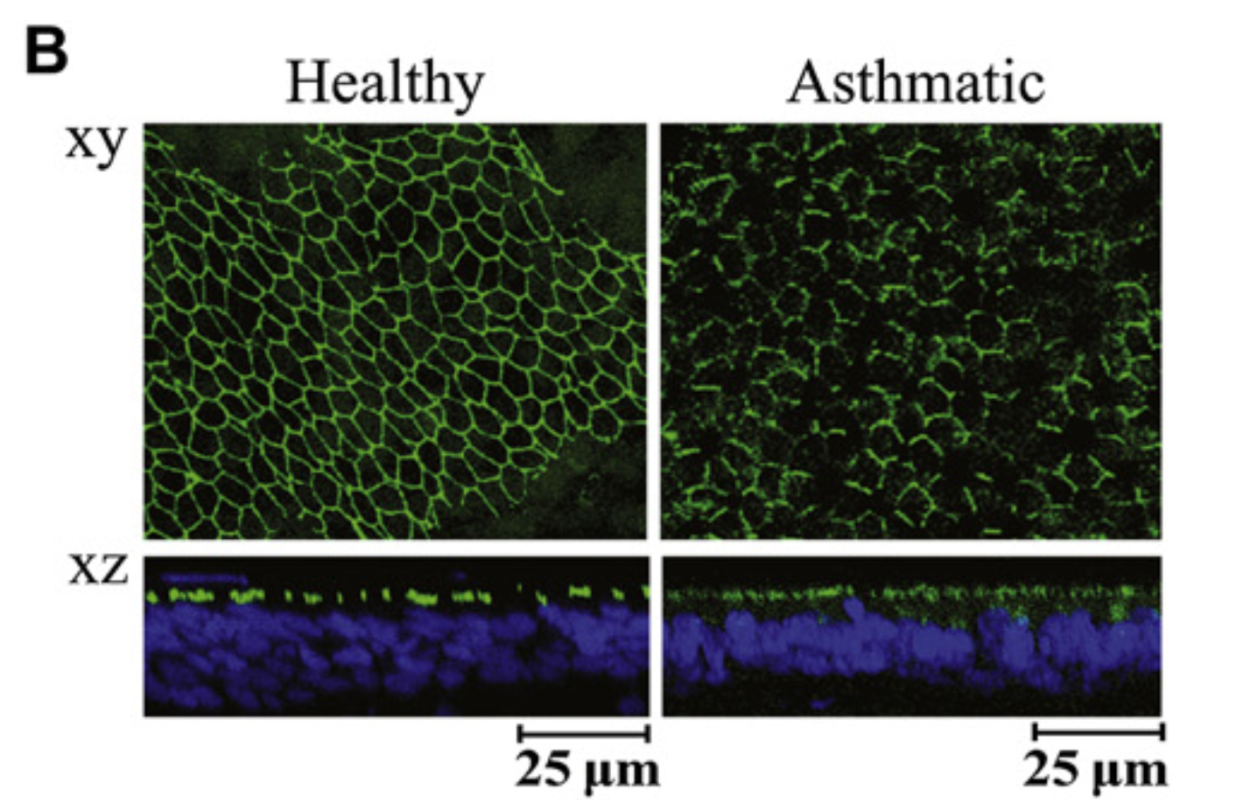
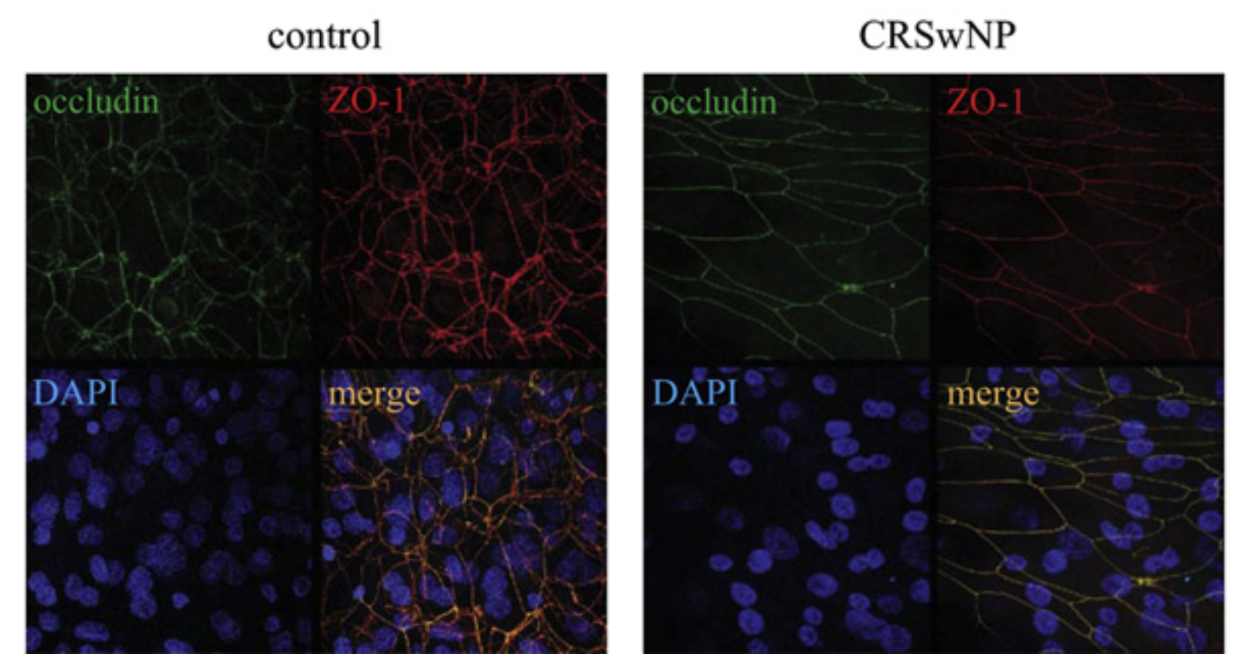
Dysfunction of tight junctions in asthma and CRS^{1,2}
Lower airwaysª
Upper airways
Healthy¹
Asthmatic¹
Healthy²
CRSwNP²

Slide 10




Towards restoring epithelial barrier function¹
Allergens
House dust mite, pollen
Pollutants
PM_{2.5/10}, DEP
Cigarettes
Detergents
NO₂, O₃
Pathogens
Bacteria
Fungi
Viruses
00
Inflammatory mediators
TNF, IFN-γ
IL-4, IL-13
TGF-β1, OSM
Histamine
Others
Hypoxia
Genetic/epigenetic
Radiation
Damage
Others
Nasal irrigation
Chinese medicine
Biologics
Repair
Antibiotics
Antibacterial
Antifungal
Antiviral
Small molecules
Pathway inhibitor
Cystatin SN
HDAC inhibitor
Allergy medications
Steroid, antihistamine
Mast cell stabiliser

